Slide 1
Conditional GAN

Slide 2
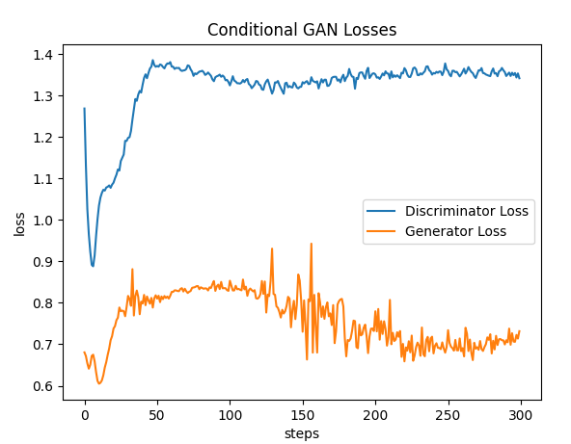
Conditional GAN
Batch: 256
Learning rate = 1e-5
Epochs = 300
C_critics = 0

Slide 3
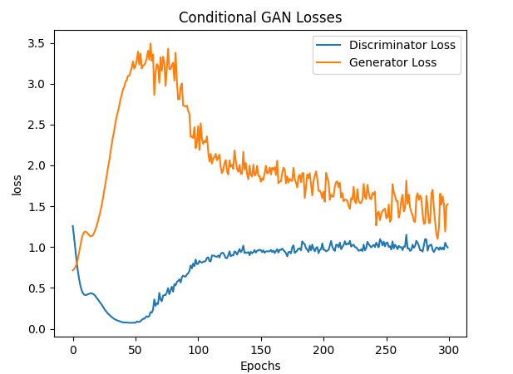
Conditional GAN
Batch: 256
Learning rate = 1e-5
Epochs = 300
C_critics = 3

Slide 4
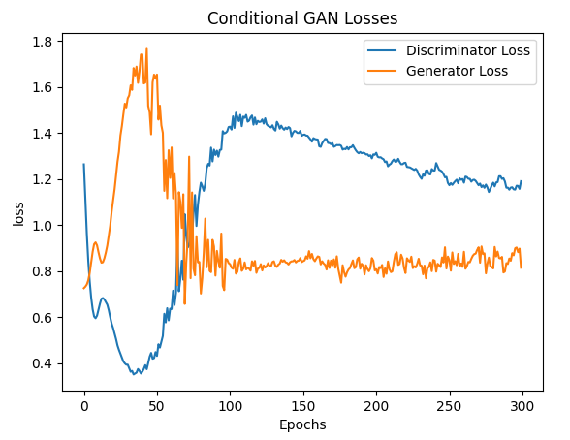
Conditional GAN
Batch: 256
Learning rate = 1e-5
Epochs = 300
C_critics = 2

Slide 5
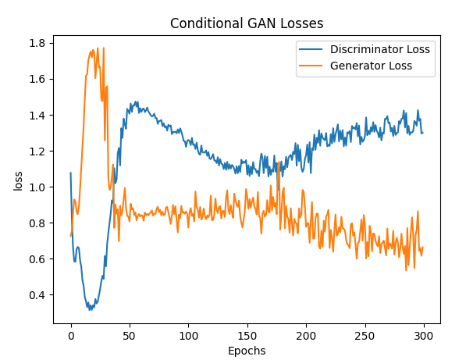
Conditional GAN
Batch: 128
Learning rate = 1e-5
Epochs = 300
C_critics = 2

Slide 6
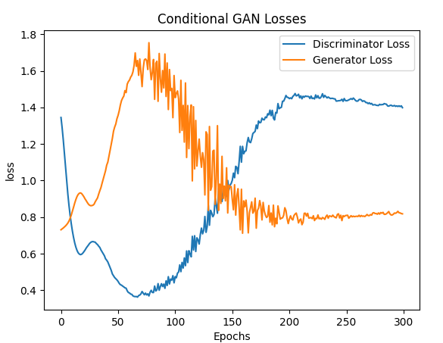
Conditional GAN
Batch: 512
Learning rate = 1e-5
Epochs = 300
C_critics = 2

Slide 7
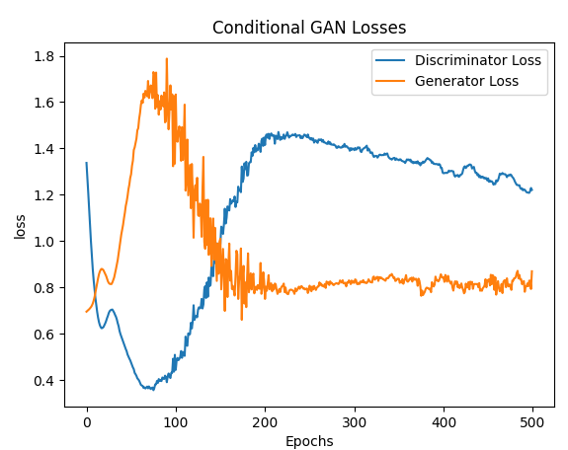
Conditional GAN
Batch: 512
Learning rate = 1e-5
Epochs = 500
C_critics = 2

Slide 8
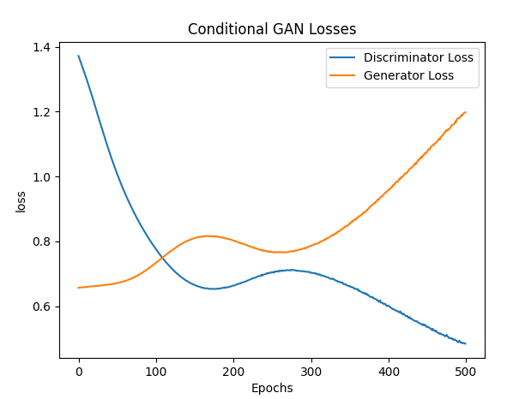
Conditional GAN
Batch: 512
Learning rate = 1e-6
Epochs = 500
C_critics = 0

Slide 9
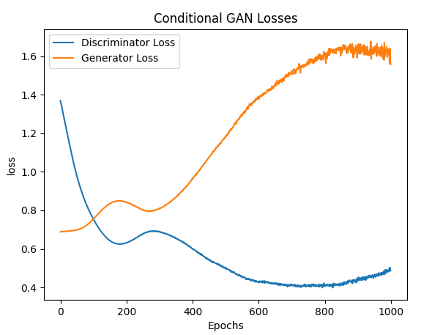
Conditional GAN
Batch: 256
Learning rate = 1e-6
Epochs = 1000
C_critics = 2

Slide 10
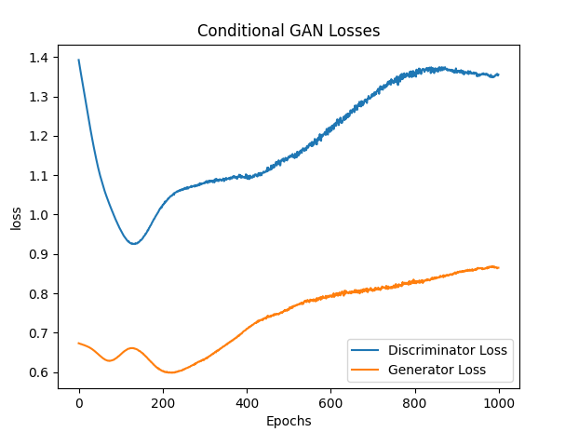
Conditional GAN
Batch: 512
Learning rate = 1e-6
Epochs = 1000
C_critics = 1

Slide 11
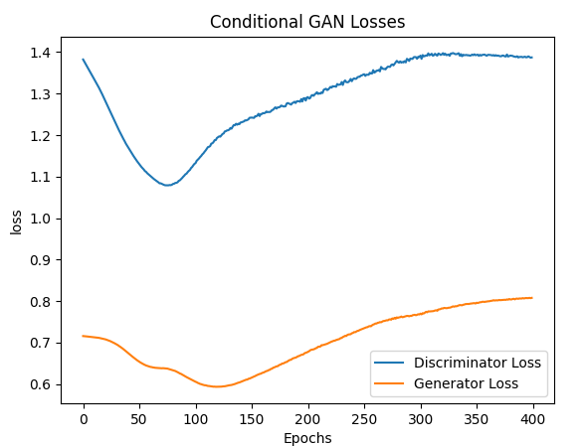
Conditional GAN
Batch: 512
Learning rate = 1e-6
Epochs = 400
C_critics = 1
Both d and G are at 1024

Slide 12
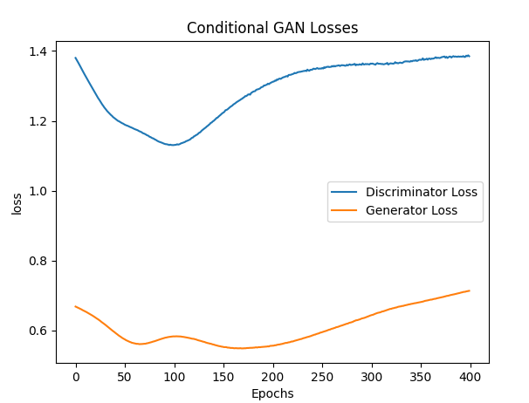
Conditional GAN
Batch: 512
Learning rate = 1e-6
Epochs = 400
C_critics = 1
G are at 1024
D at 512

Slide 13
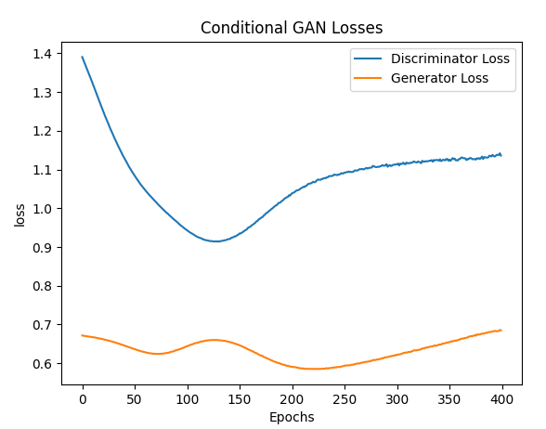
Conditional GAN
Batch: 512
Learning rate = 1e-6
Epochs = 400
C_critics = 2
G are at 1024
D at 512

Slide 14
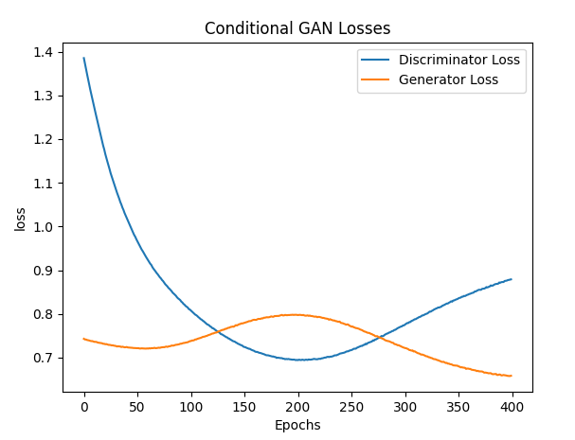
Conditional GAN
Batch: 512
Learning rate = 1e-6
Epochs = 400
C_critics = 1
Both d - 512and G are at 1024

Slide 15
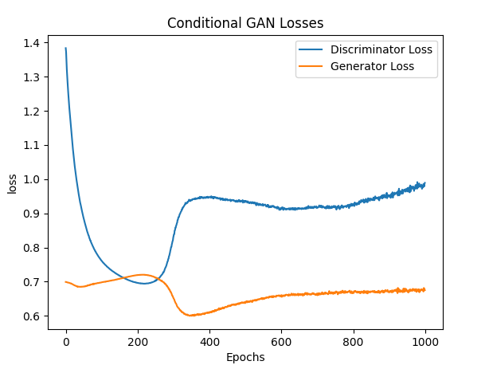
Conditional GAN
Batch: 248
Learning rate = 1e-6
Weight decay =0.01
Epochs = 1000
C_critics = 1
Both d and G are at 1024

Slide 16
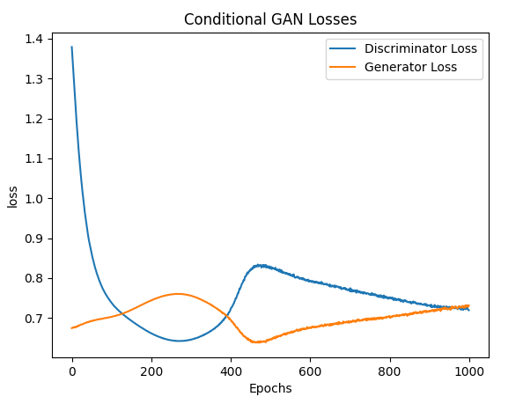
Conditional GAN
Batch: 248
Learning rate = 1e-6
Epochs = 400
C_critics = 3

Slide 17
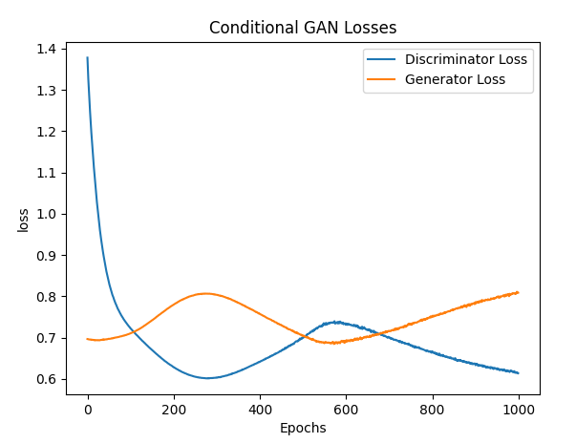
Conditional GAN
Batch: 248
Learning rate = 1e-6
Epochs = 400
C_critics = 3

Slide 18
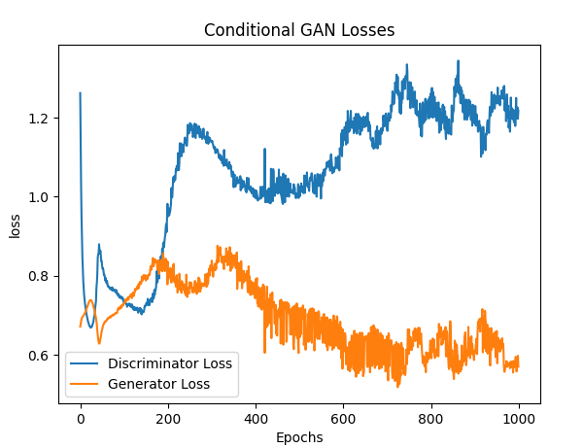
Conditional GAN
Batch: 248
Learning rate = 1e-5
Epochs = 400
C_critics = 3

Slide 19
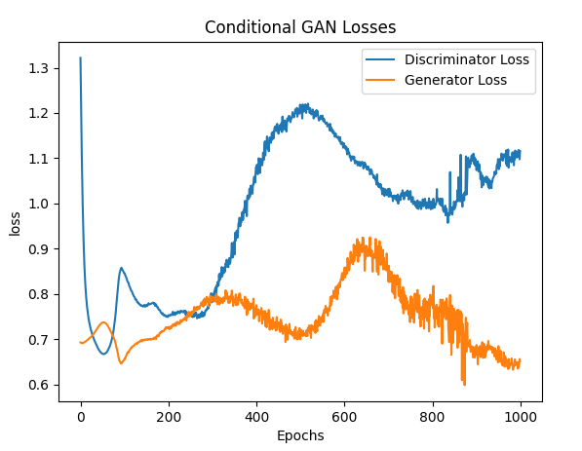
Conditional GAN
Batch:512
Learning rate = 1e-5
Epochs = 400
C_critics = 3

Slide 20
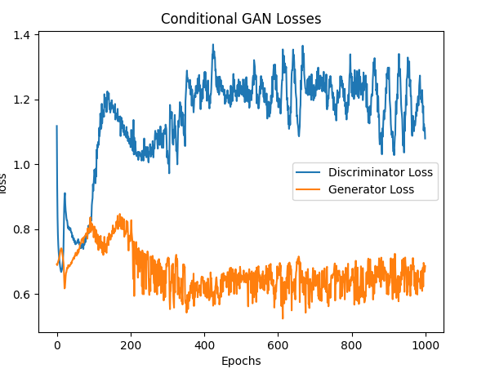
Conditional GAN
Batch: 128
Learning rate = 1e-5
Epochs = 400
C_critics = 3

Slide 21
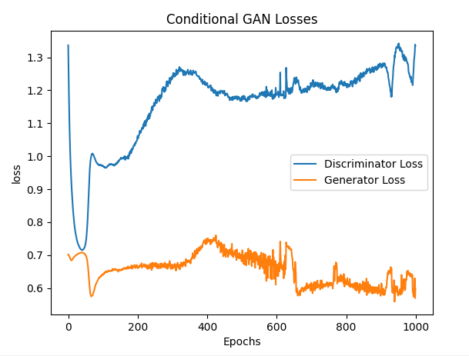
Conditional GAN
Batch: 512
Learning rate = 1e-5
Epochs = 400
C_critics = 2

Slide 22
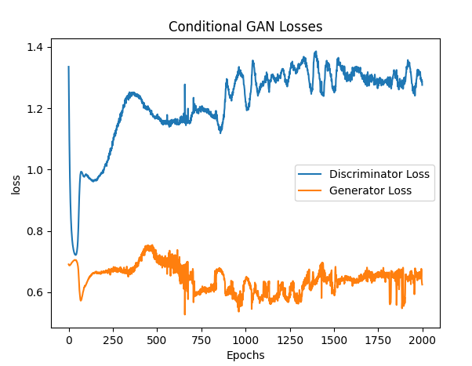
Conditional GAN
Batch: 512
Learning rate = 1e-5
Epochs = 400
C_critics = 2

Slide 23
Conditional GAN
Batch: 248
Learning rate = 1e-6
Epochs = 400
C_critics = 3

Slide 24
Conditional GAN
Batch: 248
Learning rate = 1e-6
Epochs = 400
C_critics = 3

Slide 25
Conditional GAN
Batch: 248
Learning rate = 1e-6
Epochs = 400
C_critics = 3

Slide 26
Conditional GAN
Batch: 248
Learning rate = 1e-6
Epochs = 400
C_critics = 3

Slide 27
Deep Convolutional Conditional GAN

Slide 28
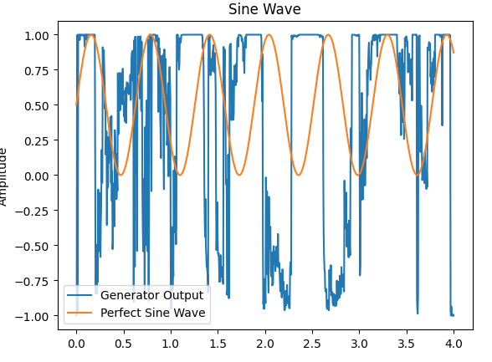
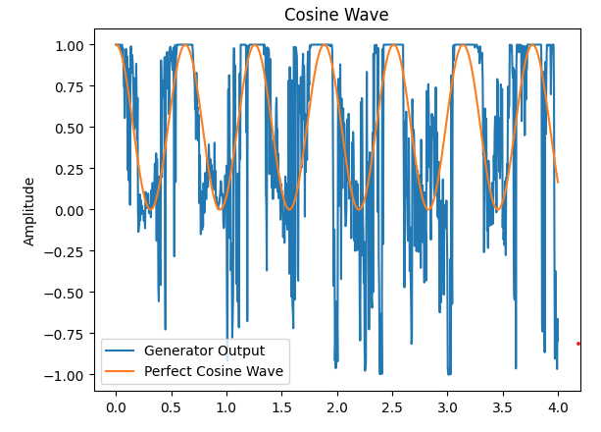
Deep Conditional GAN

Slide 29
WGAN

Slide 30
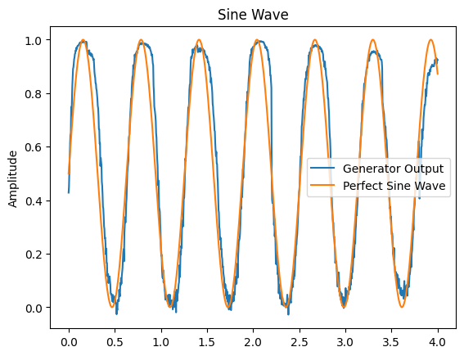
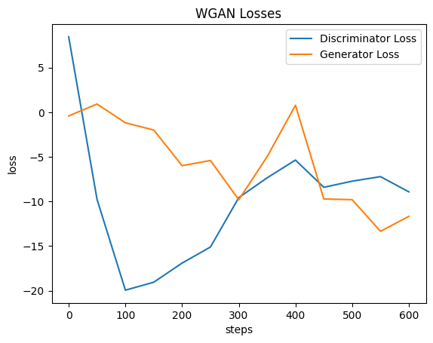
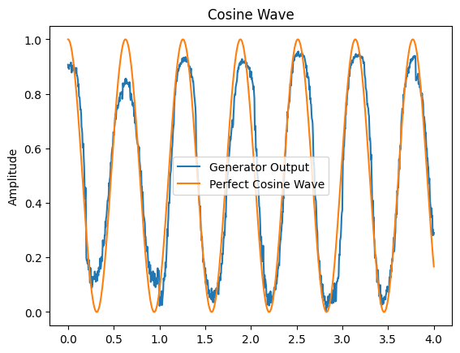
WGAN

Slide 32
Conditional GAN

